Slide 1


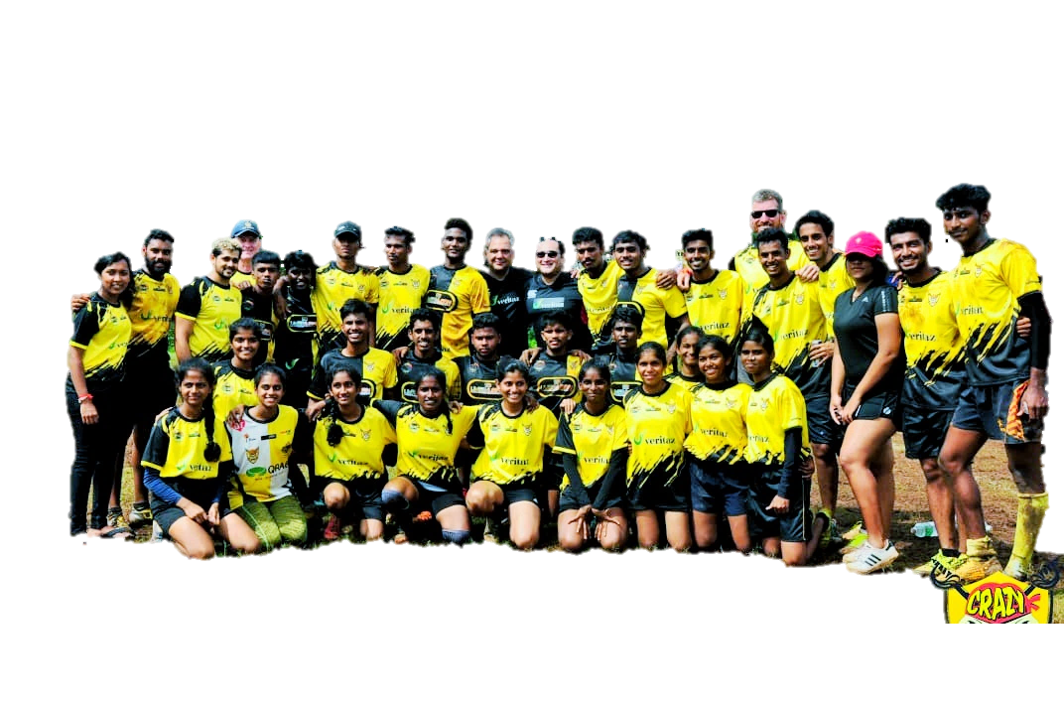
CRAZY PIRATES
#WEARECRAZY

Slide 2

Brief about us
Founded on 13th Jan 2015, we are a product of Pure Passion, Talent, Discipline and Determination.
The club has been running for FOUR SEASONS now and in that time we have had over 1000 different young people use our training facilities, come along at our training sessions or play for one of our league tournaments held over the state.
The aim is not to take a center stage in Rugby, it is to do something with and for the local promising talent.

Slide 3
Our approach
Personal interaction and scouting of pure and promising raw talent for the team to understand our vision and team values.
We offer opportunities for both girls and boys to learn life skills through the medium of Rugby, we teach them the benefits of, among other things, team work, time management, respect, social responsibility and we try to develop a work ethic all within a safe and FUN environment.

Slide 4
vision
To create a supportive environment where positive and competitive rugby can be played and enjoyed by all ages regardless of gender, culture, caste, politics or religion.
mission
Nurture our players to ensure excellent retention levels by developing individuals with discipline and respect for each other on and off the field, outstanding performance, effective coaching, remarkable team work and good facilities.

Slide 5
Achievements
SEASON #GA2
SEASON #GA3
SEASON #GA4
SEASON #GA5
  U-19 Runners up in the Services Cup friendly on 4th of April 2015
  Senior Men's Category - Winners GTL16
  Senior Women's Category-Winners GTL16
  Senior Mix Category - Winners GTL16
Senior Women winners for all Friendly
Social Media Championship 2017 for the month of June-july
U-18 boys Veritaz cup winners 2018
  Senior Women's Category-Winners Halloween Touch 2016
  Senior Mix Category - Halloween Touch 2016
  Runners up U-13 Girls Halloween Touch 2016
  Runners up U-13 MIX Halloween Touch 2016
  Senior Mix Category Winners Carnival Touch 2016

Slide 6



Statistics
CRAZY PIRATES
500
MEMBERS
10
TEAMS
110
PLAYERS
5000+ SUPPORTERS

Slide 7
All the talent in the world won’t take us anywhere without all our pirates
#WEARECRAZY

